Slide 1



Nuclear Medicine Operations Platform
Centralized Multi-Site Inventory, Production & RAG AI Management System
Project Type Healthcare Tech
TEAM MEMBERS:
Muhammad Abdullah abdullahwasavailable@gmail.com
Abubakar Ali ali.prince.x786@gmail.com
Ali Akbar aliakbar0089@gmail.com
Fareha farehaamir152@gmail.com
Syeda Masooma Batool masoomabatool212@gmail.com

Slide 2
INTRODUCTION

Slide 3



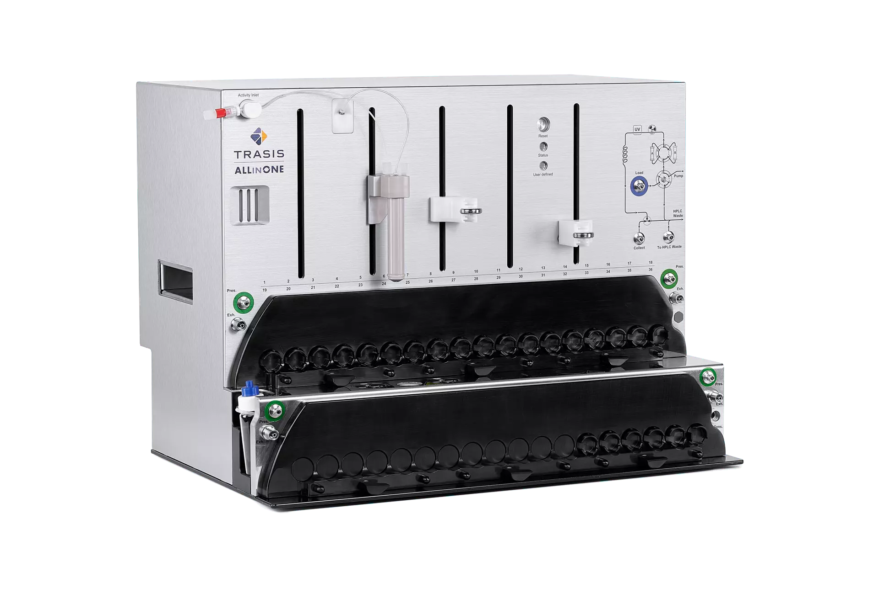


Background
Business Model: Import Equipment & Consumables → Hospital Placement → Synthesizer Dose Production → PET Scan Cancer Diagnosis
Equipment & Hospital Placement
Imported Consumable Kit Specs
The company imports advanced synthesis modules and places them directly at client hospital sites (e.g., AKUH, DUHS, JPMC) to produce radioisotopes on-demand.
Max 2 Production Runs
ABT Synthesizers: Lower yield / targeted dose output per production run.
(12759) FDG-DUAL Cassette
(15115) Reagent Part I
(15115) Part II Mannose
(15115) Part II WFI 1000ml
(12144) Venting Filter + Needle
(1785) 0.22µm Sterilizing Filter
Trasis Synthesizers: High capacity batch synthesis for multiple patient scans.
(11665) 25ml Sterile Vial
(2132) BBraun Sampling Spike
Max 4 Production Runs
(12759) FDG-QUAD Cassette
(14225) Reagent Part I
(14225) Part II Mannose
(14225) Part II WFI 1000ml
(12144) Venting Filter + Needle
(1785) 0.22µm Sterilizing Filter
(11665) 25ml Sterile Vial
(2132) BBraun Sampling Spike

Slide 4
PROBLEM

Slide 5







Today's Fragmented Operational Flow
Current Challenge: Isolated departmental tools (Excel, WhatsApp, Paper) create blind spots, inventory mismatches, & untracked patient dose risks.
Warehouse
Transfer & Receiving
Hospital Production
Monthly Reconciliation
Tool: Central Excel
Tool: WhatsApp / Email
Tool: Site Excel & Paper
Tool: Manual Copy-Paste
Logs dispatch of 10 kits based on hospital POs.
Hospital receives 9 kits; receipt confirmed via chat or DC.
Engineer decrements run counts,downtime,kit utilization on ABT / Trasis manually.
3 different numbers for dispatched, received & used kits.
1. Manual Run Tracking Error
2. Defect & Expiry Blindspot
3. Unlinked Machine Downtime
Engineer uses KIT-001 Quad (4 runs) on Trasis synthesizer but forgets to update Excel. Next shift assumes 4 runs remain, causing unexpected batch halt during patient PET scan preparation.
Hospital finds defective sterilizing filter on KIT-045 and reports on WhatsApp. Message gets buried. Meanwhile, KIT-002 Dual (WFI/Mannose) expires at AKUH without automated warning.
ABT synthesizer suffers a 2.5h card fault at DUHS resulting in 1 failed run (420 mCi lost). Logged on paper, management cannot connect downtime to lost patient revenue or supplier claims.

Slide 6
The Problem Statement:
"The issue isn't a lack of data—it's that critical operational data is scattered across spreadsheets, chats, and individual memories, blinding management to real-time risks."
The Solution:
An end-to-end operational platform unifying inventory life-cycles, transfer verification, production logs, and machinery telemetry into a single source of truth.

Slide 7
SOLUTION

Slide 8







Target Centralized Operational Flow
Target State: A single centralized platform uniting Import, Warehouse Stock, Hospital Synthesizers, Component Issues, & Executive Analytics.
Import & Customs
Warehouse Hub
Hospital Operations
Synthesizer Run
Executive Portal
Auto-register Batch, Expiry & Kit IDs (FDG-DUAL/QUAD)
Digital Dispatching & QR Transfer Confirmation
Real-Time Kit Receipt & Automatic 30-Day Expiry Alert
Auto-Decrement Runs (2 or 4) & Dose Activity (mCi) Log
Instant Machine Yield, Downtime & Supplier Defect Reports
Today's Fragmented Operations
Target Centralized Platform
✕
Dispatched (25), Received (23), and Used (20) numbers require days to reconcile manually.
✓
Single Source of Truth across Import → Warehouse → Hospital → Synthesizer.
✕
Manual run decrements lead to human overwrite errors and surprise stockouts.
✓
Automated Kit Run Tracking with real-time audit trail and zero overwrite risk.
✕
Defective components (e.g. filter on KIT-045) lost in WhatsApp group chats.
✓
Structured defect logging directly linked to Kit ID & Supplier Claim claims.
✕
High dependency on individual employee knowledge during staff absences.
✓
Instant executive dashboard answering Q3 failure rates & machine downtime in 1 click.

Slide 9
APPLICATION

Slide 10
User Roles & Responsibilities
Admin
Warehouse Manager
Hospital Manager
Full system oversight
Warehouse operations
Site operations
• Sites, users, inventory, production, issues, downtime, reports, exports and AI-assisted analysis.
• Create templates, receive/manage stock, create kits, initiate transfers, resolve issues and manage expiry.
• Confirm receipts, manage site inventory, enter daily summaries, production, downtime and site issues.

Slide 11
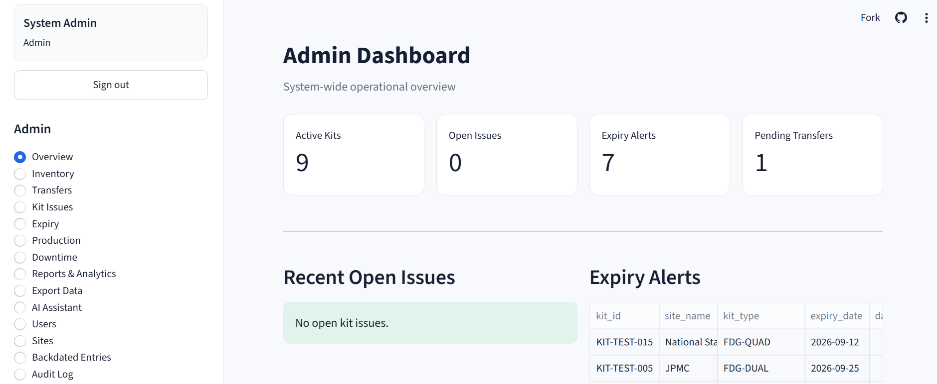
User Roles & Responsibilities
Admin
Warehouse Manager
Full system oversight
Sites
users
inventory
production
issues
downtime
Reports
Exports
AI-assisted analysis.

Slide 12
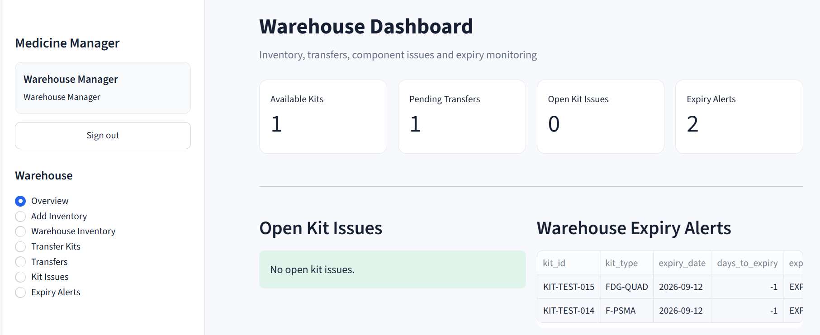
User Roles & Responsibilities
Warehouse
Manager
Warehouse Manager
Warehouse operations
Create templates
Receive/manage stock
Create kits
Initiate transfers
Resolve issues
Manage expiry

Slide 13
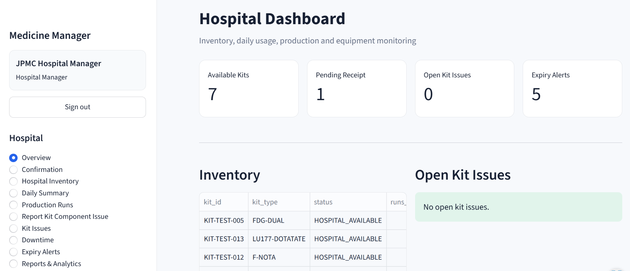
User Roles & Responsibilities
Hospital Manager
Warehouse Manager
Warehouse operations
Confirm receipts
Manage site inventory
Enter daily summaries
Production
Downtime
Site issues.

Slide 14
OPERATIONAL WORKFLOW

Slide 15
Core Operational Workflow
From kit preparation to hospital use and historical traceability
1
2
3
4
5
6
Template
Kit Creation
Transfer
Receipt
Daily Use
Completion
Standard kit +
component definition
Unique Kit ID, lot,
Cat. no. and run capacity
Warehouse sends kits
to a specific hospital
Hospital confirms
delivery before stock
becomes active
Usage is recorded
against Kit ID
in Daily Summary
When runs are exhausted,
kit leaves active
hospital inventory
Key Design Principle
Production Runs do not ask for Kit ID. Kit usage is tracked only in Daily Summary, preserving a clean separation between production events and inventory consumption.

Slide 16

Inventory Status Lifecycle
Status Code | Location State | Operational Meaning | Allowed Action
WAREHOUSE_AVAILABLE | Warehouse | In stock and ready for clinical dispatch | Initiate Transfer
RECEIPT_PENDING | In Transit | Dispatched to hospital; unconfirmed | Confirm Receiving
HOSPITAL_AVAILABLE | Hospital | Confirmed physical stock ready for usage | Record Kit Usage
ISSUE_OPEN | Hospital / Blocked | Blocked due to component defect report | Resolve Component
CONSUMED / EXPIRED | Archived | Fully used or expired (retained in history) | Read-Only Reports

Slide 17
Inventory, Expiry & Radioactive Decay Control
Warehouse Inventory
Hospital Inventory
Expiry Alerts
Stock is created and managed centrally. Managers can prepare standard templates, add kits and initiate hospital transfers.
Transferred kits appear only after receipt confirmation. Completed or expired kits are removed from active stock.
Admin sees an alert when an inventory item/kit has two months or less remaining.
Imported Materials
Expiry Action
For internationally ordered radioactive items, travel and injection duration can be incorporated into planning so decay is considered before administration.
“Mark as expired” is available only when the stock is actually expired (including 0 days to expiry). Warehouse and hospital managers can mark unused expired stock.
• All entries carry dates; backdated entries are allowed and surfaced to Admin for review.
• Warehouse and hospital inventory remain logically separate while preserving transfer history.
6

Slide 18
Kit & Component Issue Management
Controlled resolution without component-by-component manual reconciliation
1. Report Issue
2. Hold Availability
3. Warehouse Resolves
4. Hospital Confirms
Hospital records a kit/component issue associated with the affected run context.
Affected kit is treated as unavailable for use while the issue remains unresolved.
Action: “Set as Resolved by Sending Items.” Replacement quantities are not manually resolved per component.
Replacement is confirmed by the hospital and the issue moves to completed history.
Warehouse Issue Workspace
Hospital Issue Workspace
Two tabs: Resolve Issue and Waiting Confirmation. Once resolved, the issue leaves the selectable unresolved list and waits for hospital confirmation.
Two tabs: Kits and Components by Kit. Components by Kit supports filtering by Kit ID to identify affected components.
• Every issue remains traceable through issue history and administrative reporting.
• Replacement/confirmation status prevents duplicate resolution actions.
7

Slide 19
Production, Daily Summary & Performance
ABT Production
Trasis Production
Daily Hospital Summary
Record production runs, activity received (mCi), failures/mishandling and machine-specific performance.
Track Trasis runs separately from ABT for clear operational and performance reporting.
Daily counts of ABT/Trasis runs, activity and total patients served. This is the single location for kit usage tracking.
Failures
Downtime
Performance
Capture production failures such as equipment/card faults, mishandling or other operational causes.
Record equipment downtime and analyze its impact by site, machine and date range.
Date/site filters support ABT and Trasis comparisons across production, patients, failures and downtime.
Nuclear Medicine Inventory & Operations Management System
8

Slide 20
HOW WE DID IT?

Slide 21
Technology Stack
Cloud-first architecture suitable for Streamlit Community Cloud deployment
Frontend / App
Backend Logic
Database
Streamlit
Interactive role-based web interface
Python
Business rules, validation, workflows
Supabase
Authentication
Data & Analytics
Excel Export
Supabase Auth
User authentication and role-aware access
Pandas + Streamlit Charts
Reporting, summaries and performance views
XlsxWriter
Multi-sheet Excel workbooks
AI
Deployment
Source Control
Gemini 3.6 Flash
Admin AI / RAG-assisted analysis
Streamlit Community Cloud
Cloud-hosted application delivery
GitHub
Version control and deployment source
Nuclear Medicine Inventory & Operations Management System
11

Slide 22
High-Level System Architecture
Cloud-hosted application with centralized database and role-aware access
Users
Admin
Warehouse Manager
Hospital Manager
Application
Streamlit Web App
Python
Authentication
Supabase Auth
Role-based access
Database
Supabase
Admin AI / RAG Layer • Gemini 3.6 Flash • Database-grounded analysis
AI Key Handling
Admin enters Gemini API key in the AI section; key should not be hard-coded in source control.
10

Slide 23
WHAT WE ACHIEVED?

Slide 24







Sustainable Development Goals Alignment
Our solution contributes directly to 3 key UN Sustainable Development Goals (SDGs) & operational excellence
UN SDG 3
UN SDG 9
UN SDG 12
Good Health &
Well-being
Industry, Innovation &
Infrastructure
Responsible Consumption
& Production
Supports timely and reliable cancer diagnostic services through optimized management of radiopharmaceutical production, decay schedules, and hospital clinical operations.
Digitizes nuclear medicine operations by seamless integration of inventory, production synthesisers, equipment maintenance, and hospital patient demand into one centralized platform.
Improves consumable utilization, shelf-life expiry monitoring, and batch inventory planning—significantly minimizing avoidable clinical waste and radioisotope decay loss.
Core Operational & Sustainability Impact
Better Healthcare
Smarter Operations
Less Waste
Driving sustainable value across healthcare delivery, infrastructure, and resource efficiency

Slide 25
CONCLUSION

Slide 26
Conclusion
We are not simply digitizing Excel sheets. We are connecting inventory, production and operational data into one system so that healthcare teams can move from manual tracking to informed decision-making.
Centralized , Traceable & Role-Based Solution
The proposed platform provides a single, controlled operational environment for nuclear medicine inventory, kit lifecycle, production, issues, expiry, downtime and management reporting.

Slide 27
THANK YOU!
TEAM MEMBERS:
Muhammad Abdullah abdullahwasavailable@gmail.com
Abubakar Ali ali.prince.x786@gmail.com
Ali Akbar aliakbar0089@gmail.com
Fareha farehaamir152@gmail.com
Syeda Masooma Batool masoomabatool212@gmail.com

